Slide 1

Car First Aid: Database Design and Backend Implementation
This report details the database design and backend implementation for the Car First Aid mobile application. This sophisticated automotive diagnostic platform leverages AI for multi-modal fault diagnosis. The system uses a robust PostgreSQL database to support complex diagnostic workflows, user management, mechanic services, and real-time communication.

Slide 2

Executive Summary & Core Data Categories
The Car First Aid application manages a comprehensive ecosystem of interconnected data elements, organized into five primary categories. These categories serve specific functional requirements within the diagnostic and service delivery framework, ensuring a robust and scalable system.
Core Data Categories
User Management Data
Professional Mechanic Data
The implementation adheres to industry best practices for data security, scalability, and performance optimization, while maintaining flexibility for future feature expansion.
Multi-Modal Diagnostic Data
AI Processing Results
Communication and Feedback Data

Slide 3
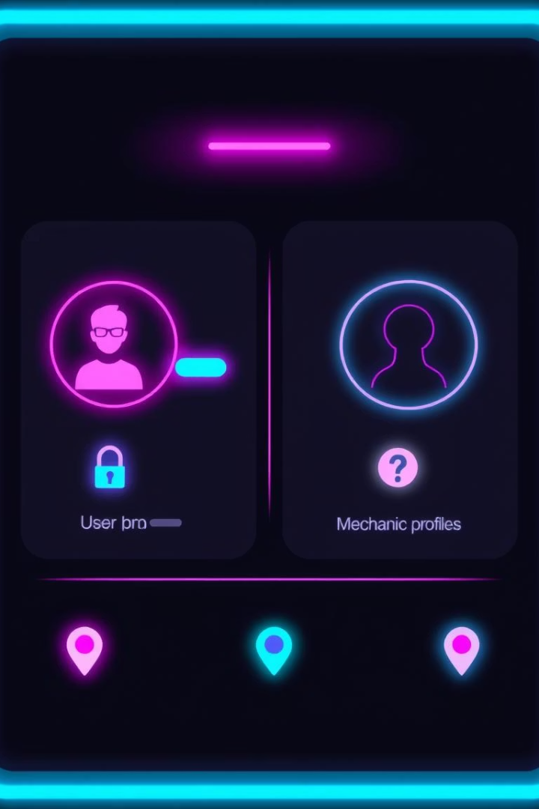
User & Mechanic Data Structures
User Management Data Architecture
Forms the foundation of security and personalization. Includes user profiles (names, emails, phones), securely hashed passwords (bcrypt), role-based access controls, and JWT for stateless authentication.
Professional Mechanic Data Structure
Represents the service provider ecosystem. Captures detailed profiles (bio, experience, certifications), dynamic performance metrics (ratings), geographic location for service matching, and availability schedules.

Slide 4



Diagnostic & AI Processing Data
Multi-Modal Diagnostic Data Framework
Supports three input types: dashboard light analysis (image metadata, patterns), engine sound analysis (audio metadata, feature extraction), and manual input (text descriptions, multimedia attachments).
AI Processing Results Architecture
Captures AI analysis outputs: possible causes with confidence scores, recommendations (video URLs, repair instructions, parts links). Tracks user interactions to refine recommendations.

Slide 5








Communication & Data Relationships
Communication & Feedback Data Ecosystem
User-Centric Relationships
Car owners are central, generating multiple diagnostic requests, receiving notifications, and providing feedback. This supports personalized recommendations and service quality improvements.
Implements a comprehensive feedback and notification system. Captures ratings, comments, and temporal info for services. Manages real-time notifications across channels, tracking delivery and user interaction.
Professional Service Relationships
Diagnostic Processing Relationships
Mechanics have complex relationships with feedback, consultation, and communication. Many-to-many relationships allow flexible service provider selection.
Diagnostic inputs have one-to-one relationships with results, ensuring consistency and traceability from request to recommendation.

Slide 6


Conceptual Design & System Architecture
Presentation Layer Integration
1
React Native mobile app as primary UI, responsive design, cross-platform compatibility (iOS/Android), minimal data persistence.
Business Logic Layer Architecture
FastAPI backend for diagnostic validation, AI integration, mechanic matching, workflow orchestration, authentication, and authorization.
Data Persistence Layer Design
PostgreSQL database as foundational layer, ACID compliance, advanced query optimization, referential integrity through constraints.

Slide 7

Design Principles & Data Flow
Design Principles Implementation
Data Flow Architecture
Normalization Standards: Third Normal Form (3NF) to eliminate redundancy.
User Onboarding: Registration, validation, secure token generation.
Referential Integrity: Foreign key constraints for data consistency.
Diagnostic Processing: File uploads, AI integration, result delivery.
Scalability Architecture: Designed for growth with indexing and connection pooling.
Service Integration: Mechanic matching, communication, feedback collection.
Security Framework: Bcrypt hashing, JWT tokens, least privilege access, SQL injection prevention.

Slide 8
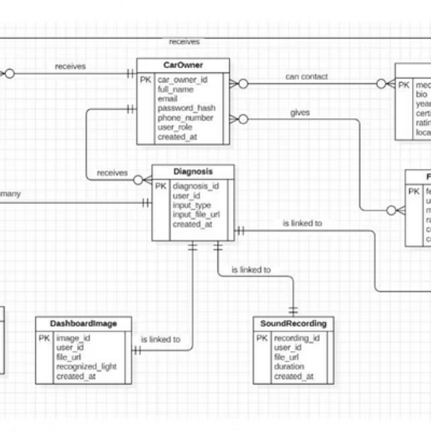

ER Diagram Analysis & Entity Structure
The Entity-Relationship diagram defines nine primary entities representing core business objects. Each is designed for specific functional requirements, data integrity, and system performance.
Key entities include CarOwner (user identification, authentication, profile), Mechanic (professional qualifications, performance tracking, location), Diagnosis (workflow coordination, input types, file management), Specialized Input (DashboardImage, SoundRecording, ManualInput), and DiagnosisResult (AI outcomes, recommendations, confidence scores).

Slide 9




Database Implementation & Technology
PostgreSQL Selection
Schema Implementation
Data Type Implementation
Migration Management
Chosen for ACID compliance, complex query support, JSON data type, advanced indexing, reliability, and extensive ecosystem.
Entities translate to tables with optimized columns, constraints (foreign key, check, unique, not-null), and strategic indexing for query performance.
Custom enumeration types for categorical data and PostgreSQL JSON data types for flexible schema elements like diagnostic results.
Alembic for schema version control, enabling systematic updates and rollbacks with structured change management processes.

Slide 10


Backend Implementation
FastAPI Framework
Authentication System
RESTful API with automatic OpenAPI documentation, asynchronous processing, and modular router organization for maintainability.
JWT token architecture for stateless security and bcrypt hashing for password protection, with refresh capabilities and complexity requirements.
Data Access Layer
Error Handling & Deployment
SQLAlchemy ORM for database abstraction, efficient session management (connection pooling, transactions), and query optimization techniques.
Comprehensive exception management, retry logic, managed PostgreSQL integration (Supabase), health checks, and performance monitoring.

Slide 11
Conclusion
The Car First Aid database and backend provide a comprehensive, production-ready foundation for a sophisticated automotive diagnostic mobile application, meeting all project requirements and supporting future growth.

